Slide 1
Introduction to Arduino Development

Slide 2
Agenda
What is a Arduino?
Why Arduino?
Arduino Boards
Required Components
Arduino IDE
Arduino code basics
Simple Projects:
Blinking LED

Slide 3
1. What is a Arduino?
Arduino is an open-source electronics platform based on easy-to-use hardware and software.
Arduino boards are able to:
Read inputs:
Light on a sensor
A finger on a button
A twitter message
Turn it into an output:
Activating A motor
Turning on an LED
Publishing something online
You can tell your board what to do by sending a set of instructions to the microcontroller on the board.

Slide 4
1. What is a Arduino?
Arduino was born at the Ivrea Interaction Design Institute as an easy tool for fast prototyping, aimed at students without a background in electronics and programming.
As soon as it reached a wider community, the Arduino board started changing to adapt to new needs and challenges,
differentiating its offer from simple 8-bit boards to products for IoT applications, wearable, 3D printing, and embedded environments.
All Arduino boards are completely open-source, empowering users to build them independently and eventually adapt them to their particular needs.
The software, too, is open-source, and it is growing through the contributions of users worldwide.

Slide 5
2. Why Arduino?
There are many other microcontrollers and microcontroller platforms available for physical computing. Parallax Basic Stamp, Netmedia's BX-24, Phidgets, MIT's Handyboard, and many others offer similar functionality.
All of these tools take the messy details of microcontroller programming and wrap it up in an easy-to-use package.
Arduino also simplifies the process of working with microcontrollers, but it offers some advantages over other systems:
Inexpensive
Cross-platform - The Arduino Software (IDE) runs on Windows, Macintosh OSX, and Linux operating systems. Most microcontroller systems are limited to Windows.
Simple, clear programming environment - The Arduino Software (IDE) is easy-to-use for beginners, yet flexible enough for advanced users to take advantage of as well..
Open source and extensible software - The Arduino software is published as open source tools, available for extension by experienced programmers. The language can be expanded through C++ libraries.
Open source and extensible hardware - The plans of the Arduino boards are published under a Creative Commons license, so experienced circuit designers can make their own version of the module, extending it and improving it.
Notes:
There are many other microcontrollers and microcontroller platforms available for physical computing. Parallax Basic Stamp, Netmedia's BX-24, Phidgets, MIT's Handyboard, and many others offer similar functionality. All of these tools take the messy details of microcontroller programming and wrap it up in an easy-to-use package. Arduino also simplifies the process of working with microcontrollers, but it offers some advantage for teachers, students, and interested amateurs over other systems:
Inexpensive - Arduino boards are relatively inexpensive compared to other microcontroller platforms. The least expensive version of the Arduino module can be assembled by hand, and even the pre-assembled Arduino modules cost less than $50
Cross-platform - The Arduino Software (IDE) runs on Windows, Macintosh OSX, and Linux operating systems. Most microcontroller systems are limited to Windows.
Simple, clear programming environment - The Arduino Software (IDE) is easy-to-use for beginners, yet flexible enough for advanced users to take advantage of as well. For teachers, it's conveniently based on the Processing programming environment, so students learning to program in that environment will be familiar with how the Arduino IDE works.
Open source and extensible software - The Arduino software is published as open source tools, available for extension by experienced programmers. The language can be expanded through C++ libraries, and people wanting to understand the technical details can make the leap from Arduino to the AVR C programming language on which it's based. Similarly, you can add AVR-C code directly into your Arduino programs if you want to.
Open source and extensible hardware - The plans of the Arduino boards are published under a Creative Commons license, so experienced circuit designers can make their own version of the module, extending it and improving it. Even relatively inexperienced users can build the breadboard version of the module in order to understand how it works and save money.

Slide 6

3. Arduino Boards

Slide 7
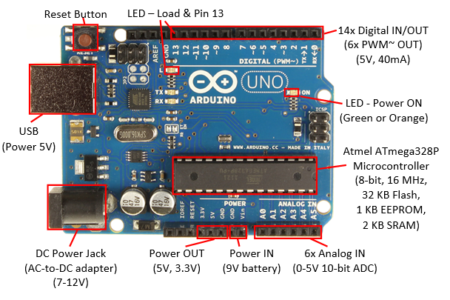
3. Arduino Boards
Arduino UNO

Slide 8
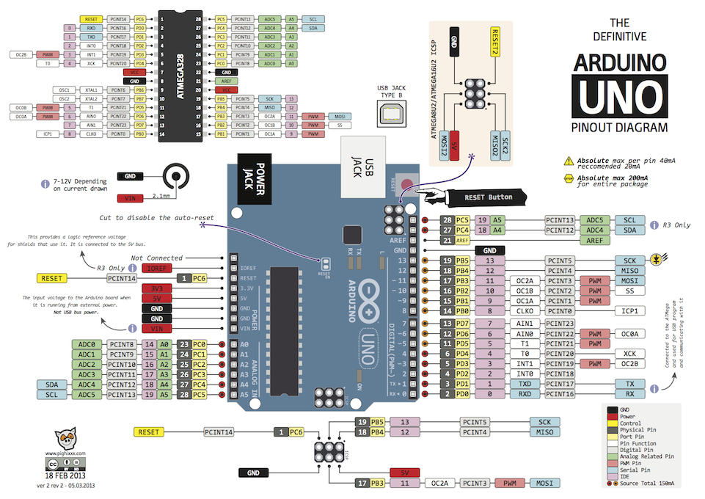
3. Arduino Boards

Slide 9
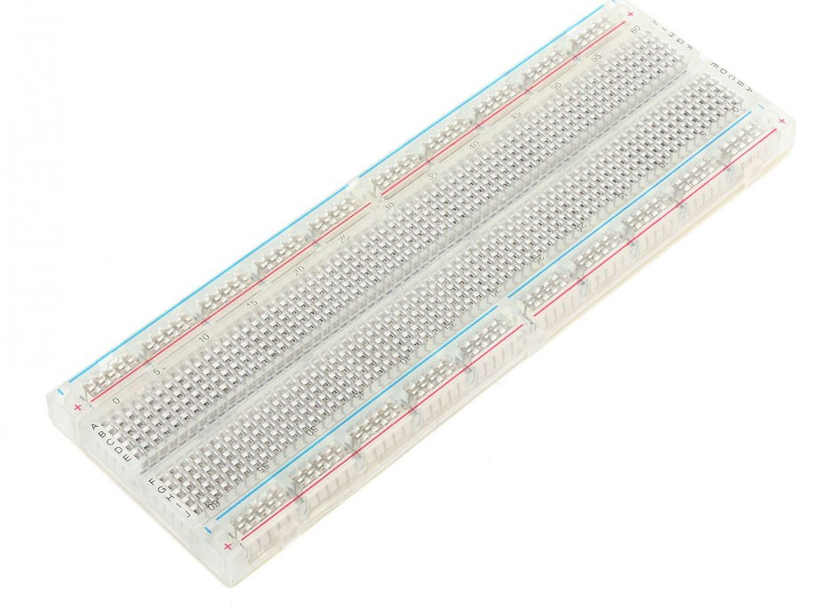
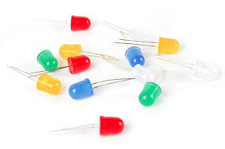
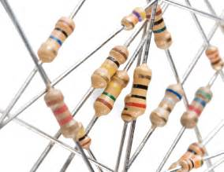
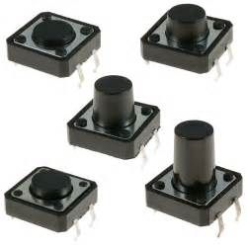
4. Required Components
In general, for the recipes of this course part you will need the following items:
An Arduino Board
A USB cable to connect the Arduino to the computer
A breadboard with a jumper wire kit
A general set of resistors with values between 100 ohm and 10,000 ohm
An assortment of general LEDs
A few push buttons and switches
Other Peripherals (As you like) “Sensors, Screens, …”.

Slide 10
Arduino IDE
Visit the Arduino website at http://arduino.cc.
In the main menu, go to the Software section.
Select your operating system and download the latest stable release (currently 1.8.4) of the Arduino software.

Slide 11
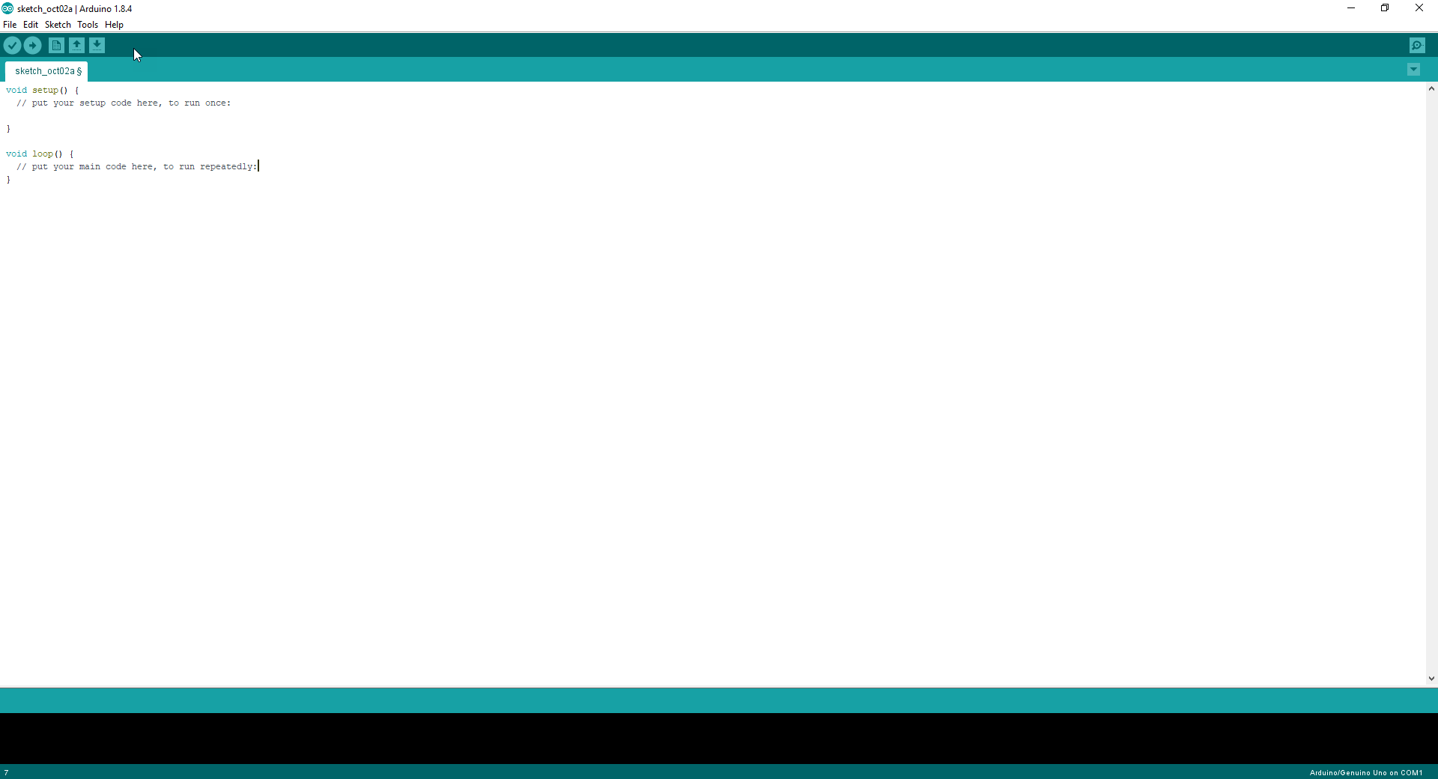
Arduino IDE
The Save button saves the current sketch.
The Open button simply allows us to open a saved sketch.
The New button starts a new program. In the Arduino world, programs are called sketches.
The Upload button compiles the code and, if there is no error in the code, uploads it to the Arduino board.
The Verify button compiles the code and checks it for errors.
This button opens the Serial Monitor window that allows us to communicate with the Arduino board. Useful for Debugging Code
Notes:
In the Sketch tab, we can see all the opened Arduino Sketches. This comes handy when we want to work on multiple programs at the same time.
The Code Space area is where all the magic happens. That's where we write the code that powers satellites and cat food dispensers. It's a code editor with automatic syntax highlighting and autoarranging.
The Status Display area indicates all the bad stuff. Whenever there are errors in the code, they will be displayed there. It also displays errors in the connection with the board. The only good thing it can display is that the code has been successfully uploaded to the Arduino board.
Additional functionality can be found in the main menu bar. Here, we have the classic File menu where we have Save, Open, Close, and also some examples. In the following recipes, more will be discussed about the menu bar components. A nice trick worth sharing is in the Tools menu—the Auto Format tool will format the code to look professional and clean.

Slide 12
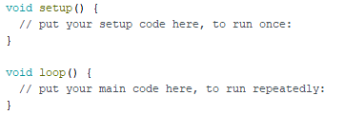
Arduino code basics
Each Arduino sketch has two mandatory functions: the setup() function and the loop() function.
The setup() function only executes once: either when we apply power to the Arduino or when it resets.
Usually, we use this function to configure the pins of the Arduino, to start communication protocols, such as serial communication.
The loop() function executes continuously.
Code in this function is executed top-down; when it reaches the end of the function, it jumps back to the start and runs again.
This happens forever until the Arduino is switched off.

Slide 13
Arduino code basics
The Arduino uses a slightly reduced C/C++ programming language. In this recipe.
// Global Variables
int var1 = 10;
int var2 = 20;
void setup() {
// Only execute once when the Arduino boots
var2 = 5; // var2 becomes 5 once the Arduino boots
}
void loop() { // Code executes top-down and repeats continuously
if (var1 > var2) { // If var1 is greater than var2
var2++; // Increment var2 by 1
} else { // If var1 is NOT greater than var2
var2 = 0; // var2 becomes 0
}
}

Slide 14
Arduino code basics
The most important feature of the Arduino is its control over digital input/output (I/O) pins.
On each pin, we can set a voltage value of 5 V, representing logic HIGH, or 0 V, representing logic LOW.
Also, we can read whether a value of 5 V or 0 V is applied externally.
void setup() {
// Set pin 2 as a digital Output
pinMode(2, OUTPUT);
// Set pin 3 as a digital Input
pinMode(3, INPUT);
}
void loop(){
// Set pin 2 HIGH
digitalWrite(2, HIGH);
// Wait 100 milliseconds
delay(100);
// Set pin 2 LOW
digitalWrite(2, LOW);
// Read the value of pin 3 and store it in a variable
int pinValue = digitalRead(3);
}
Notes:
The code sets two pins in output and input mode and then writes and reads from them.
In setup(), we use the pinMode() function to set pin number 2 as an output. When we set a pin as an output, we can set that pin as either HIGH (5 V) or LOW (0 V). Also, we set pin number 3 as an input. A pin configured as input can read external voltages applied to it. It can read HIGH if the voltage is around 5 V and LOW if the voltage is close or equal to 0 V
In the loop() function, we use the digitalWrite() function to set pin number 2 to HIGH. Then, we wait for 100 milliseconds using the delay() function. This function stops the execution of the code for the specified time, in milliseconds. Thereafter, we set the pin to LOW and wait another 100 milliseconds. In the end, we read the value of pin 3 in a variable

Slide 15
Blinking LED
// the setup function runs once when you press reset or power the board
void setup() {
// initialize digital pin LED_BUILTIN as an output.
pinMode(LED_BUILTIN, OUTPUT);
}
// the loop function runs over and over again forever
void loop() {
digitalWrite(LED_BUILTIN, HIGH); // turn the LED on (HIGH is the voltage level)
delay(1000); // wait for a second
digitalWrite(LED_BUILTIN, LOW); // turn the LED off by making the voltage LOW
delay(1000); // wait for a second
}

Slide 16
Connecting an external LED
The Arduino boards come with an internal LED connected to pin 13.
It is simple to use and always there. But most times we want our own LEDs in different places of our system.
For this recipe, we need the following ingredients:
A breadboard and jumper wires
A regular LED (the typical LED size is 3 mm)
A resistor between 220–1,000 ohm

Slide 17
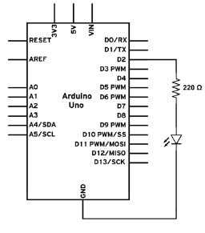
Connecting an external LED
Mount the resistor on the breadboard. Connect one end of the resistor to a digital pin on the Arduino board using a jumper wire.
Mount the LED on the breadboard. Connect the anode (+) pin of the LED to the available pin on the resistor.
Connect the LED cathode (-) to the Arduino GND using jumper wires.
We can determine the anode on the LED in two ways. Usually, the longer pin is the anode. Another way is to look for the flat edge on the outer casing of the LED. The pin next to the flat edge is the cathode (-).

Slide 18
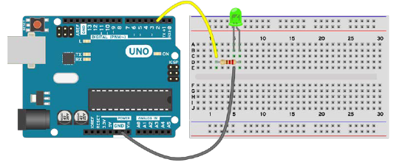
Connecting an external LED
We do need the resistor connected to the LED; otherwise there is a chance that the LED or the Arduino pin will burn.
However, we can also mount the LED first and then the resistor. This means we will connect the Arduino digital pin to the anode (+) and the resistor between the LED cathode (-) and GND.

Slide 19
Connecting an external LED
Int LED = 2;
void setup() {
// Declare the pin for the LED as Output
pinMode(LED, OUTPUT); // pinMode(2, OUTPUT);
}
// the loop function runs over and over again forever
void loop() {
digitalWrite(LED, HIGH); // turn the LED on (HIGH is the voltage level)
delay(1000); // wait for a second
digitalWrite(LED, LOW); // turn the LED off by making the voltage LOW
delay(1000); // wait for a second
}

Slide 20
Fading LED
The LED has two states: ON and OFF. But what if we want to adjust the brightness? How can we do that if we can only turn it ON or OFF? By turning it ON and OFF quickly.
We can use a technique called Pulse Width Modulation (PWM), which is built into the Arduino.
It allows us to dim the LED with up to 256 settings.
The PWM technique is used in almost all digital systems. Sound is digitally produced using this technique; that's how we can listen to music on a computer.
Arduino only has a few pins for PWM. They are usually labeled with a ~ sign. The analogWrite() function will not work on non-PWM pins.

Slide 21
Arduino Boards Recall
Arduino UNO

Slide 22
Fading LED
Int LED = 3;
void setup() {
// Declare the pin for the LED as Output
pinMode(LED, OUTPUT); // pinMode(2, OUTPUT);
}
// the loop function runs over and over again forever
void loop() {
// Here we will fade the LED from 0 to maximum, 255
for (int i = 0; i < 256; i++){
analogWrite(LED, i);
delay(5);
}
// Fade the LED from maximum to 0
for (int i = 255; i >= 0; i--){
analogWrite(LED, i);
delay(5);
}
}

Slide 23
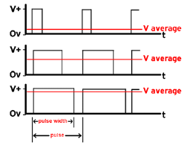
Fading LED
This all works with PWM, which works by switching between LOW and HIGH very fast.
If we turn a digital pin on and off a thousand times per second, we will obtain, on average, a voltage that is half of the HIGH voltage. If the ratio between HIGH and LOW is 2:3, the obtained voltage will be two-thirds of the HIGH voltage and so on.
Notes:
In the loop() function, we use the important PWM function analogWrite(). This function provides an analog signal on the digital PWM pin. The values for the voltage can be between 0–255, 0 for 0 volts and 255 for 5 V or 3.3 V, depending on the Arduino board used. Here, we fade in the LED slowly using a for function and then we fade it out:

Slide 24
DIY
Multiple LEDs ?
Parallel LEDs swap states
Fading without PWM
Notes:
Each LED will require its own resistor and digital pin. For example, we can mount one LED on pin 2 and one on pin 3 and individually control each. What if we want multiple LEDs on the same pin? Due to the low voltage of the Arduino, we cannot really mount more than three LEDs on a single pin. For this we require a small resistor, 220 ohm for example, and we need to mount the LEDs in series. This means that the cathode (-) of the first LED will be mounted to the anode (+) of the second LED, and the cathode (-) of the second LED will be connected to the GND. The resistor can be placed anywhere in the path from the digital pin to the GND.

